Slide 1
Storybook
For Student’s Grade

Slide 2
Grade
Teachers
Students

Slide 3
Teachers
User Name:
Password:

Slide 4
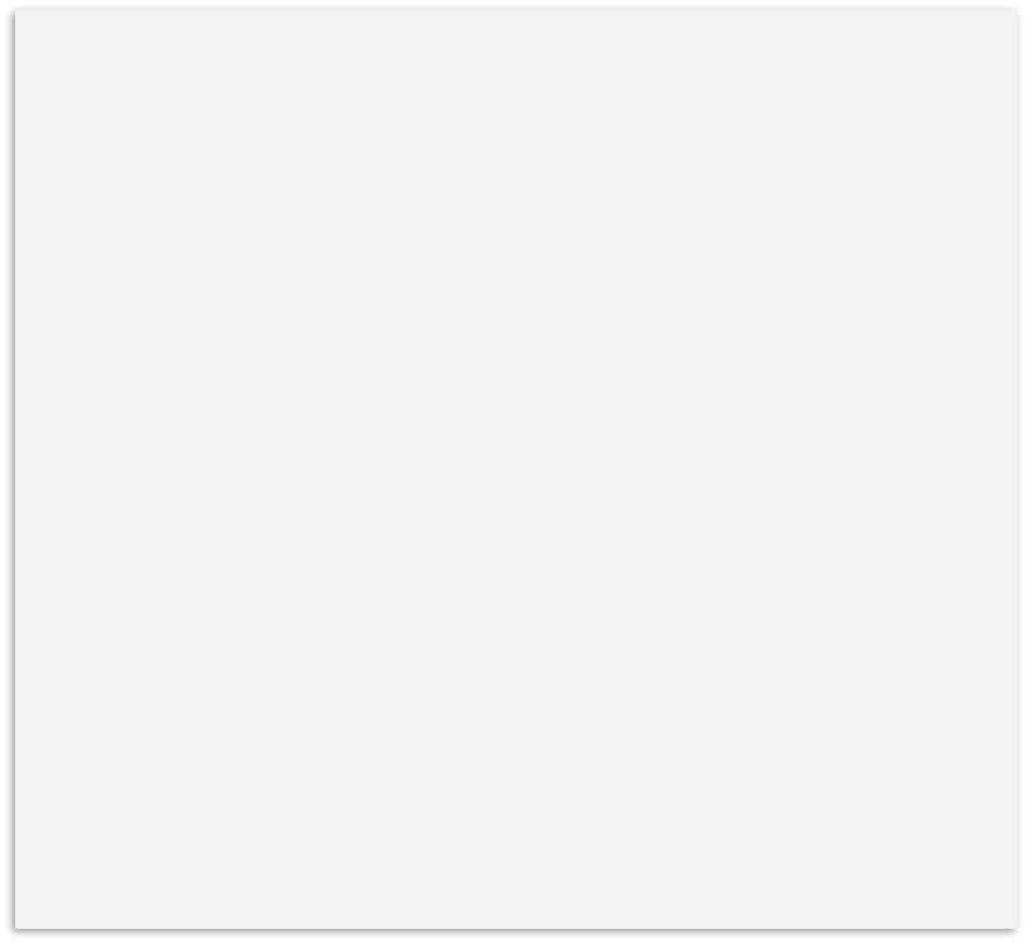
Student Records
Subjects
Math
Physics
Chemistry
Java
Web development
Search Student
Student 1
Grade
100
Student 2
Grade
95
Student 3
Grade
96
Add
Edit
Delete
Student 3
Grade
100
Add Student
Edit Student
Delete

Slide 5
Student
User Name:
Password:

Slide 6
Student Records Menu
Student Information
View Holds
Midterm Grades
Final Grades
Academics Transcripts

Slide 7
Midterm Grade
Course Name | CRN | Instructor | Terms | Number | Letter Grade | GPA
Math | 1296 | Aaron | Sprint -2015 | 96 | A | 4.00
Physics | 1234 | Charles | Spring -2015 | 100 | A | 4.00

Slide 8
Final Grade
Course Name | CRN | Instructor | Terms | Number | Letter Grade | GPA
Math | 1296 | Aaron | Sprint -2015 | 96 | A | 4.00
Physics | 1234 | Charles | Spring -2015 | 100 | A | 4.00

